Slide 1
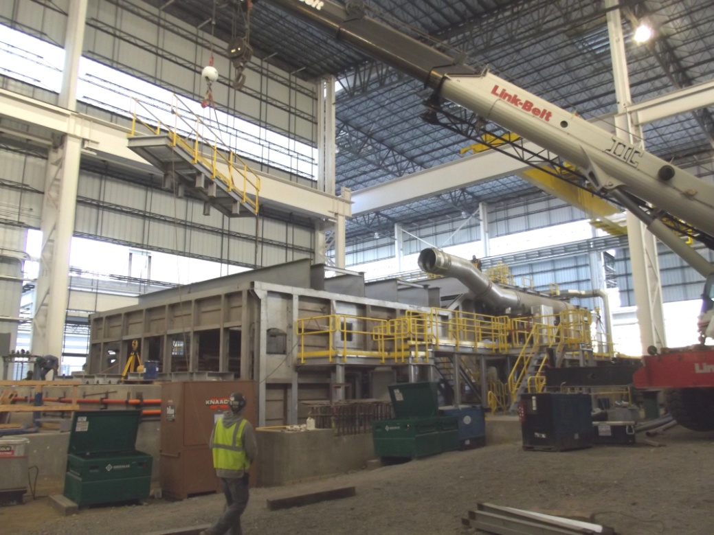
Steel Dynamics (SDI) – Pittsboro, Indiana
Project: Steel Dynamics, Pittsboro, IN
New Reheat Furnace
J13094
Scope: Equipment Installation
Equipment Installation
On Board Piping
Start-up Support
Project Equipment:
Tenovacore Furnace
Ductwork
Stack
Other

Slide 2
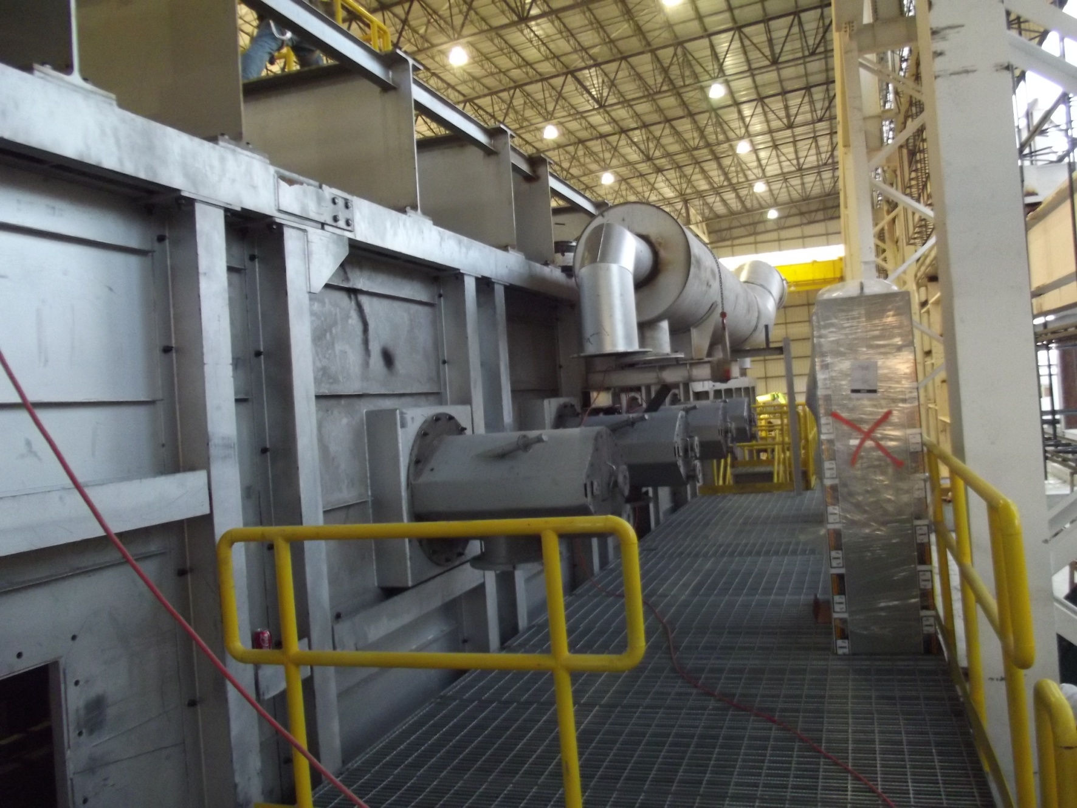
Steel Dynamics (SDI) – Pittsboro, Indiana

Slide 3
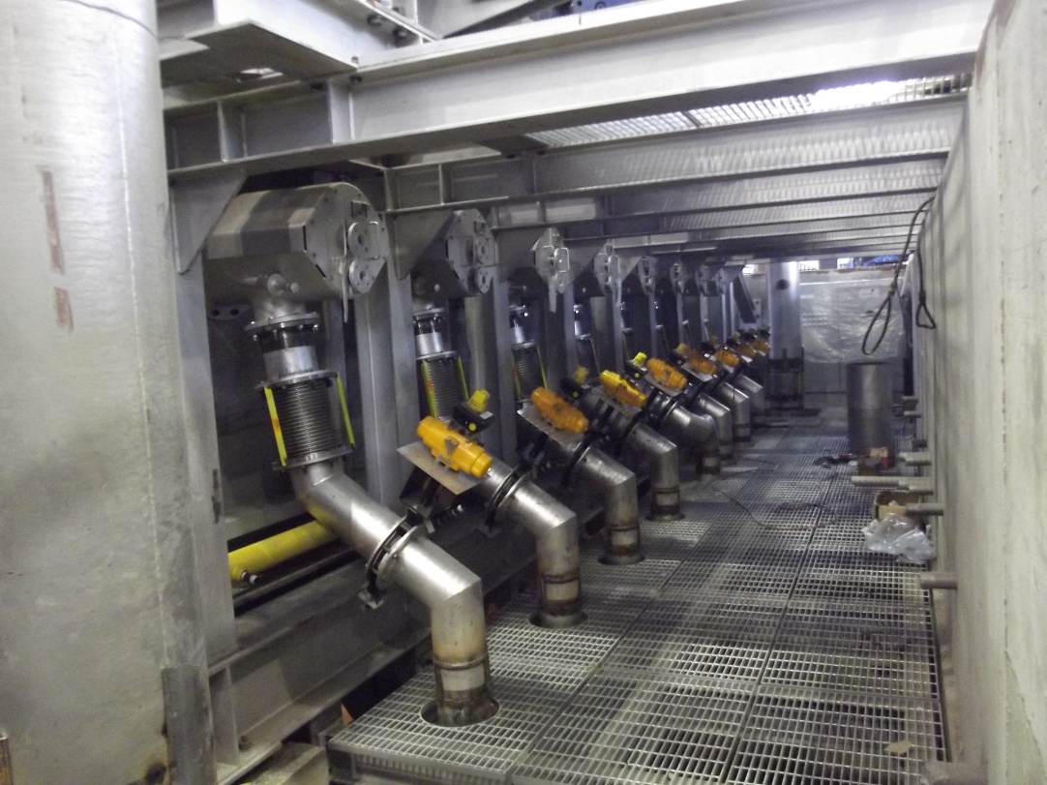
Steel Dynamics (SDI) – Pittsboro, Indiana

Slide 4
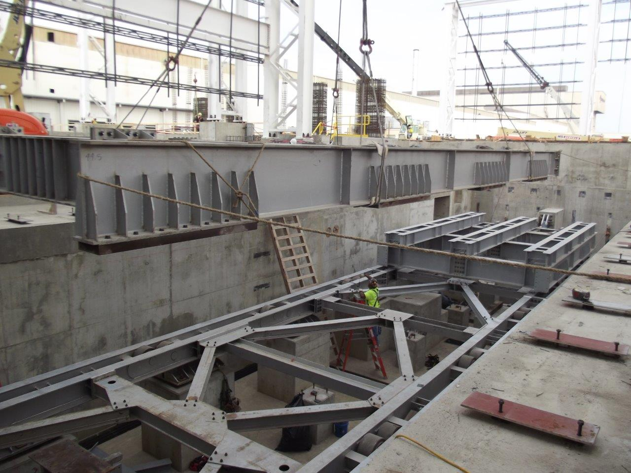
Steel Dynamics (SDI) – Pittsboro, Indiana

Slide 5
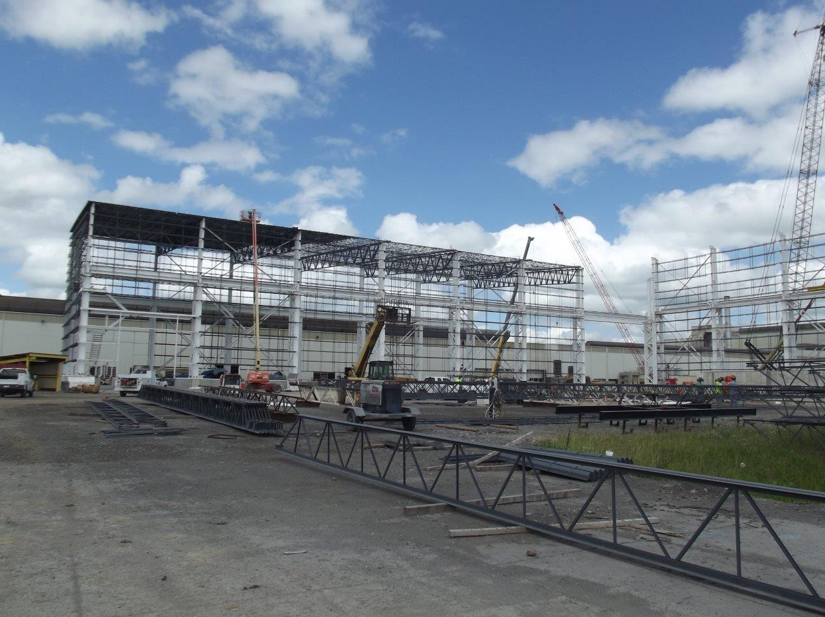
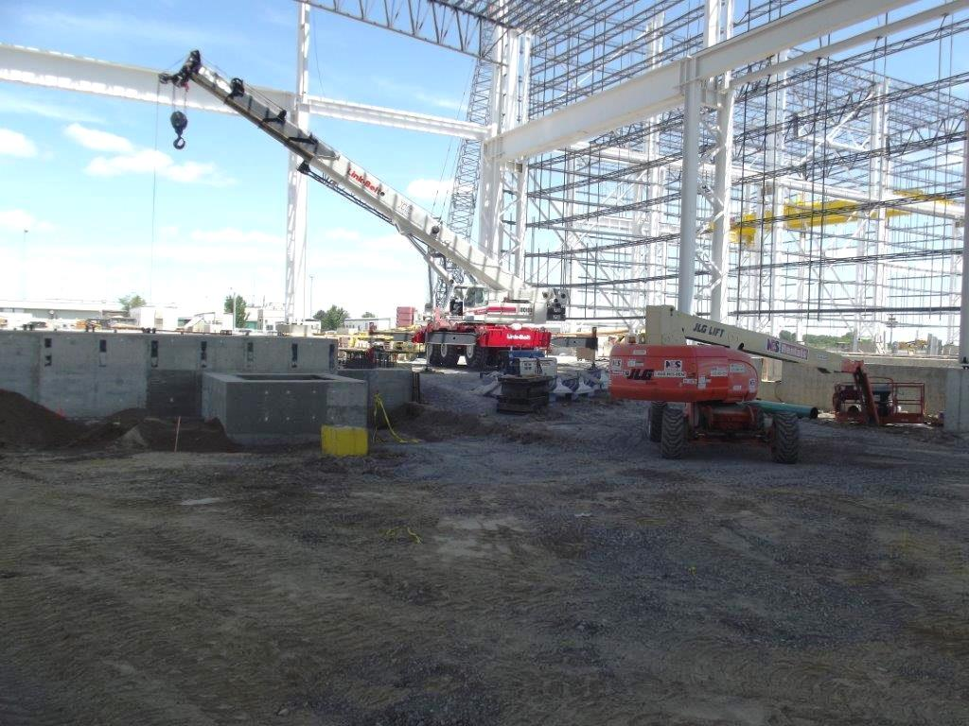
SDI, Pittsboro, Indiana

Slide 6
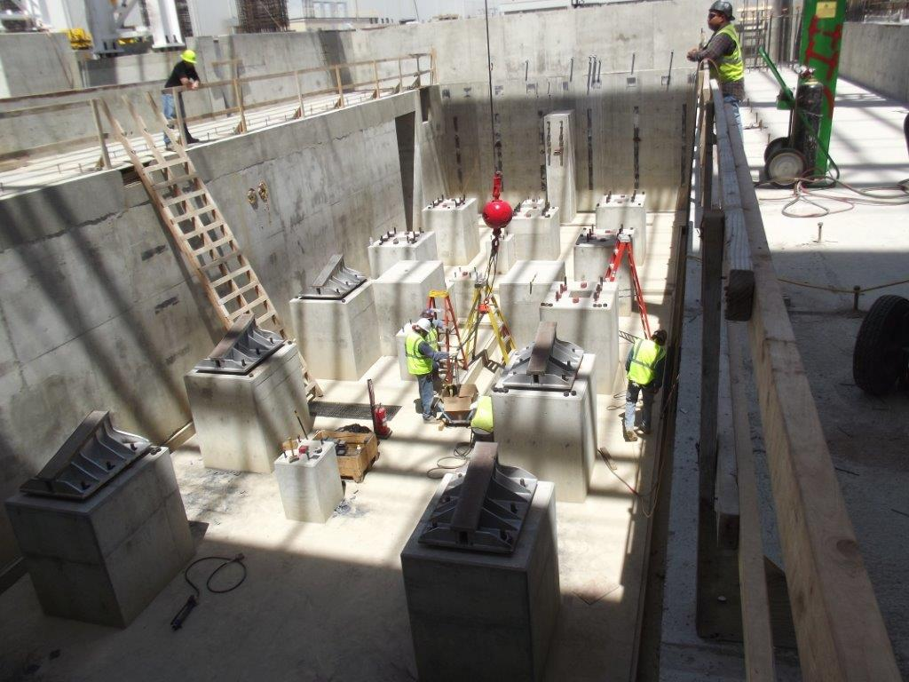
SDI, Pittsboro, Indiana

Slide 7
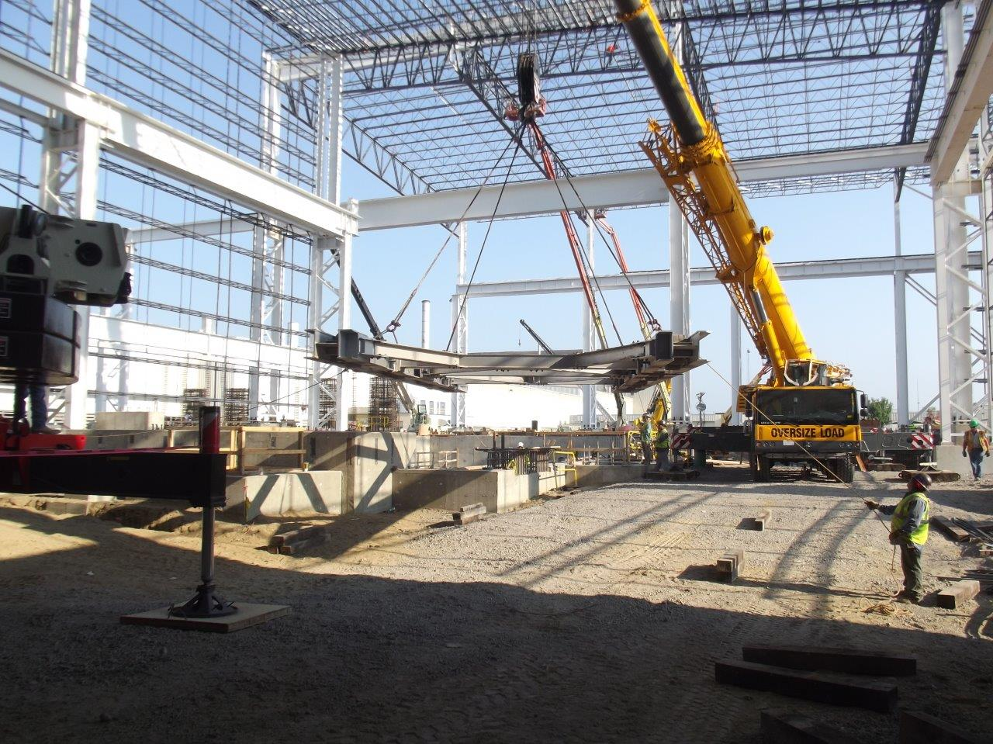
SDI, Pittsboro, Indiana

Slide 8
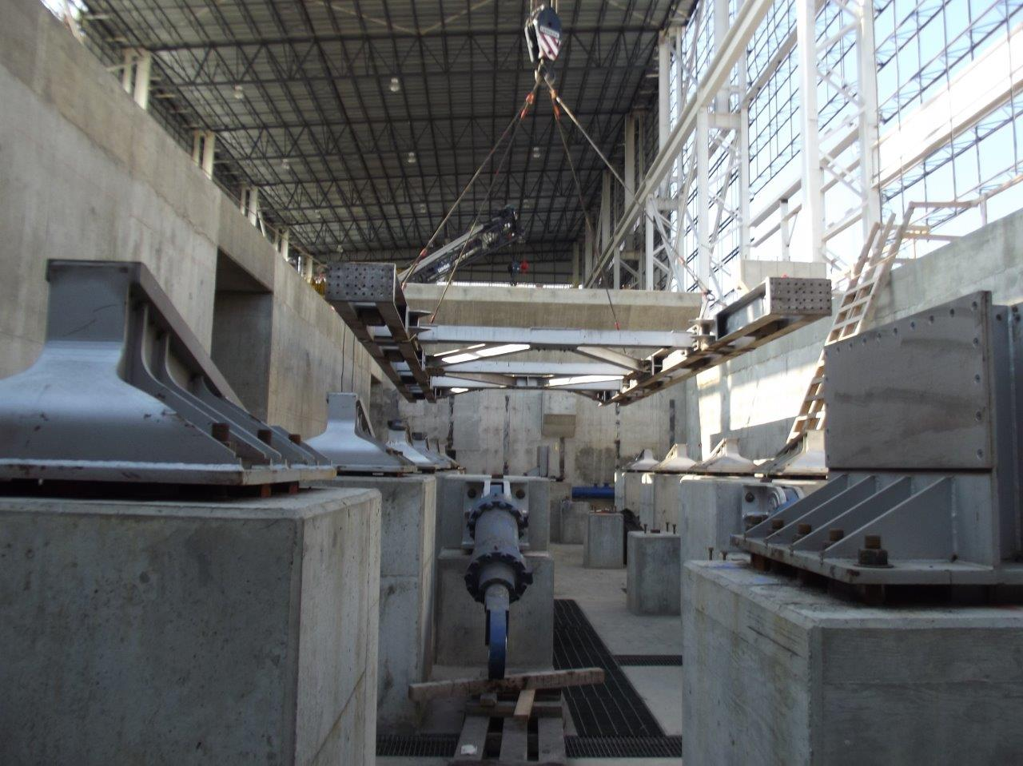
SDI, Pittsboro, Indiana

Slide 9
SDI, Pittsboro, Indiana

Slide 10
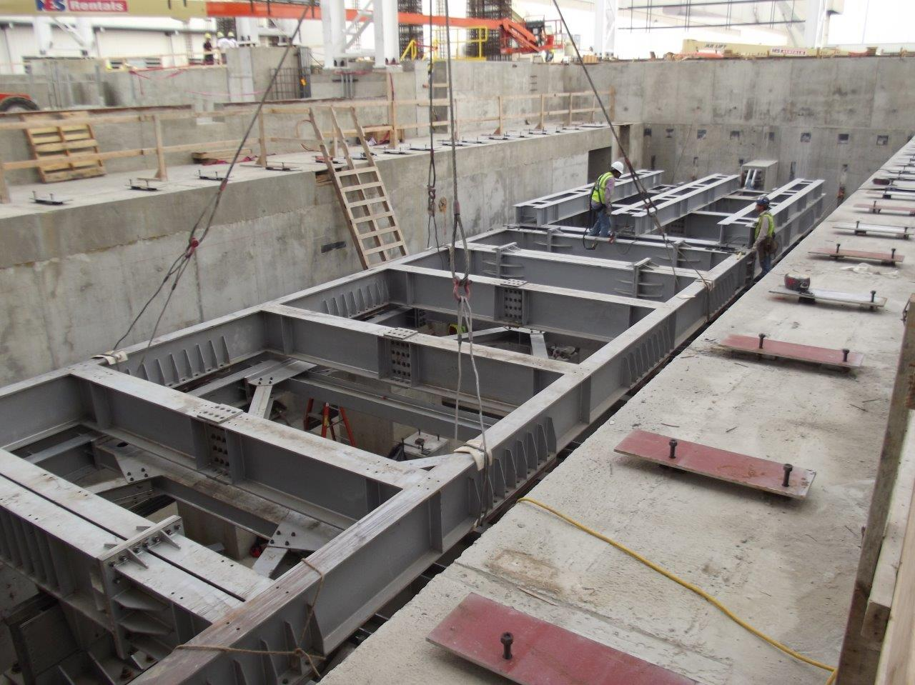
SDI, Pittsboro, Indiana

Slide 11
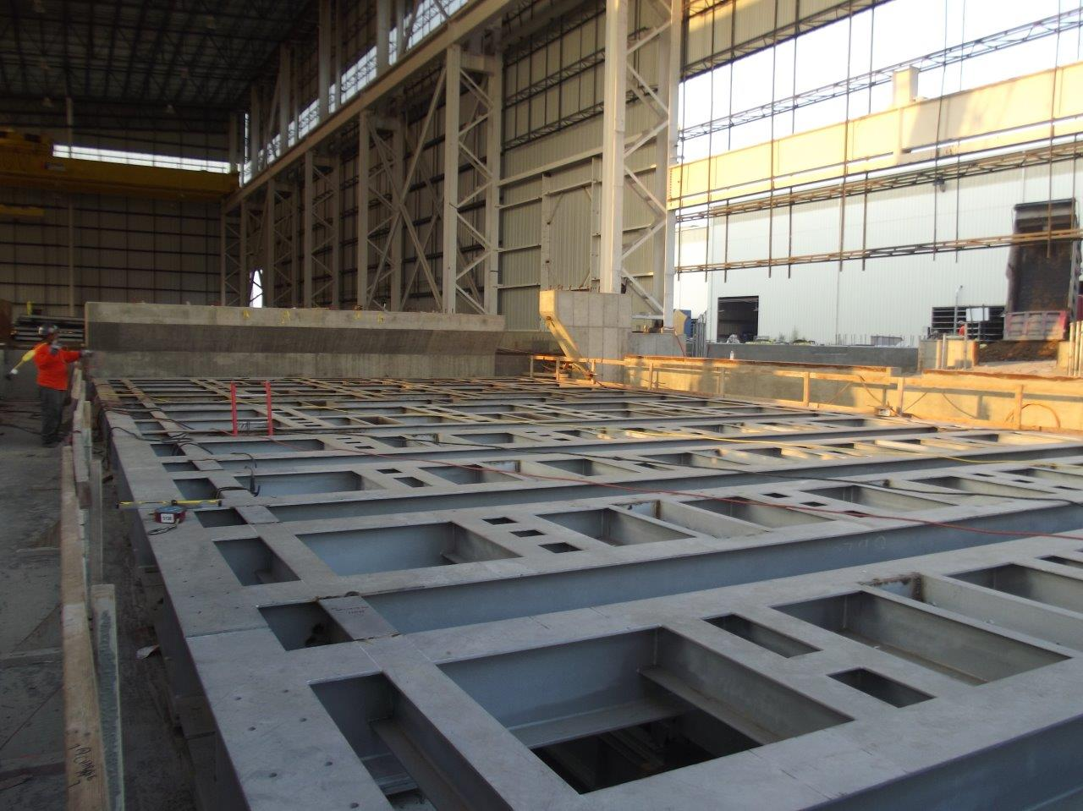
SDI, Pittsboro, Indiana

Slide 12
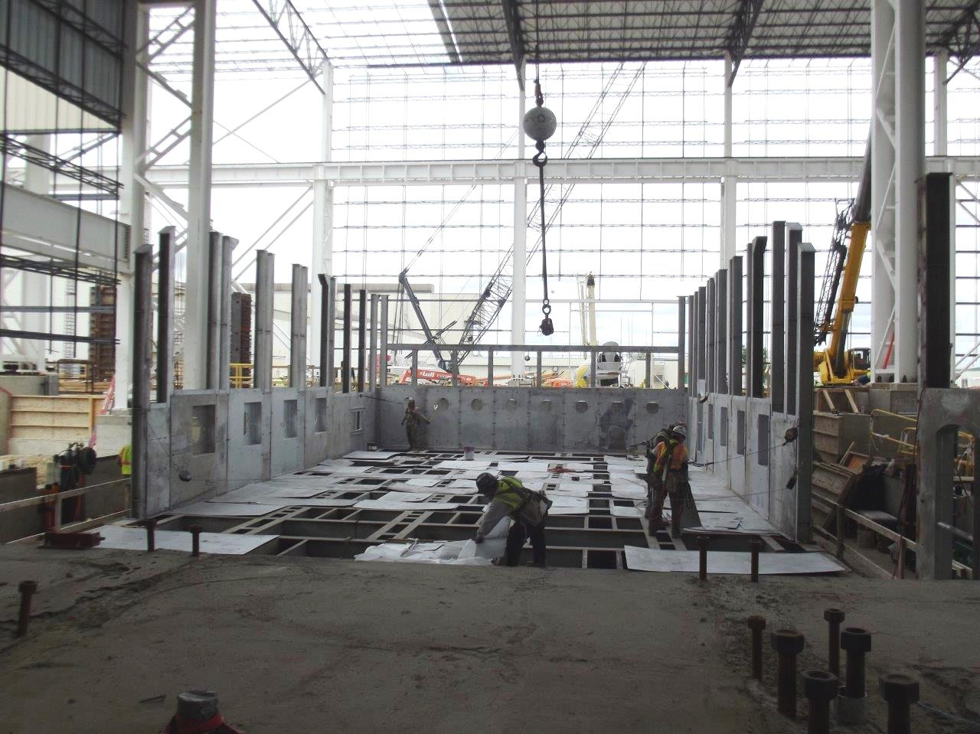
SDI, Pittsboro, Indiana

Slide 13
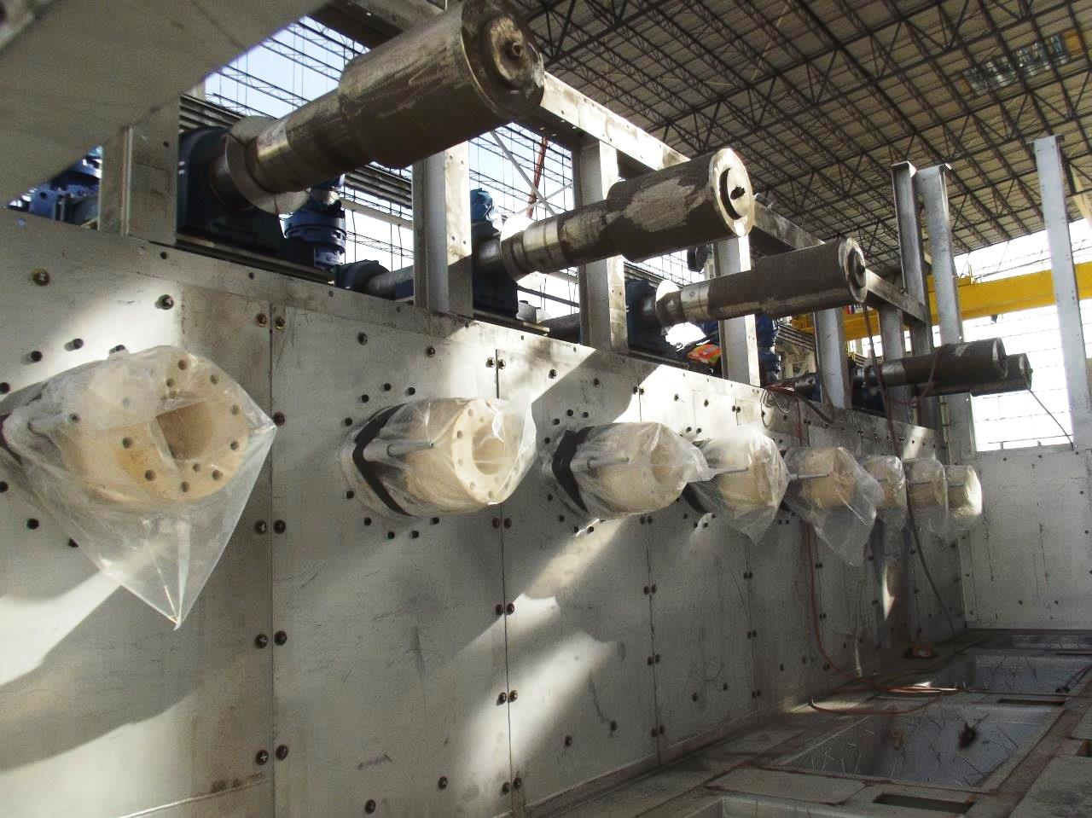
SDI, Pittsboro, Indiana

Slide 14
SDI, Pittsboro, Indiana

